Slide 1
Spam mail classification using Natural Language Processing
Hao zhou(001832050)
Huahui Chao(001817189)

Slide 2
Introduction
With the use of computer and the internet become essential to the world, the machine can also start to understand Human language, and when Artificial Intelligence and machine learning comes in our life, we start to think about the detection of different language of humans, that’s where Natural Language Processing comes in, The history of NLP dates back to the seventeenth century, when philosophers such as Leibniz and Descartes put forward proposals for codes which would relate words between languages. But all those ones remained theoretical [2]. And now the NLP becomes a power area can help people in many ways like spellcheck and autocorrect, auto-generated video captions, virtual assistants like Amazon’s Alexa, email’s suggested replies and your phone’s text prediction. This project report illustrates how the technology in Natural Language Processing work in a real-world problem: spam mail classification. Using some important ways of the text preprocessing technology like Noise removal, Tokenization, Normalization all make the text we want more related to the mail theme as to classify its attribute. We want to use different machine learning algorithm and different preprocessing technology to research how the different choice of these issues effect the robust of the model.

Slide 3
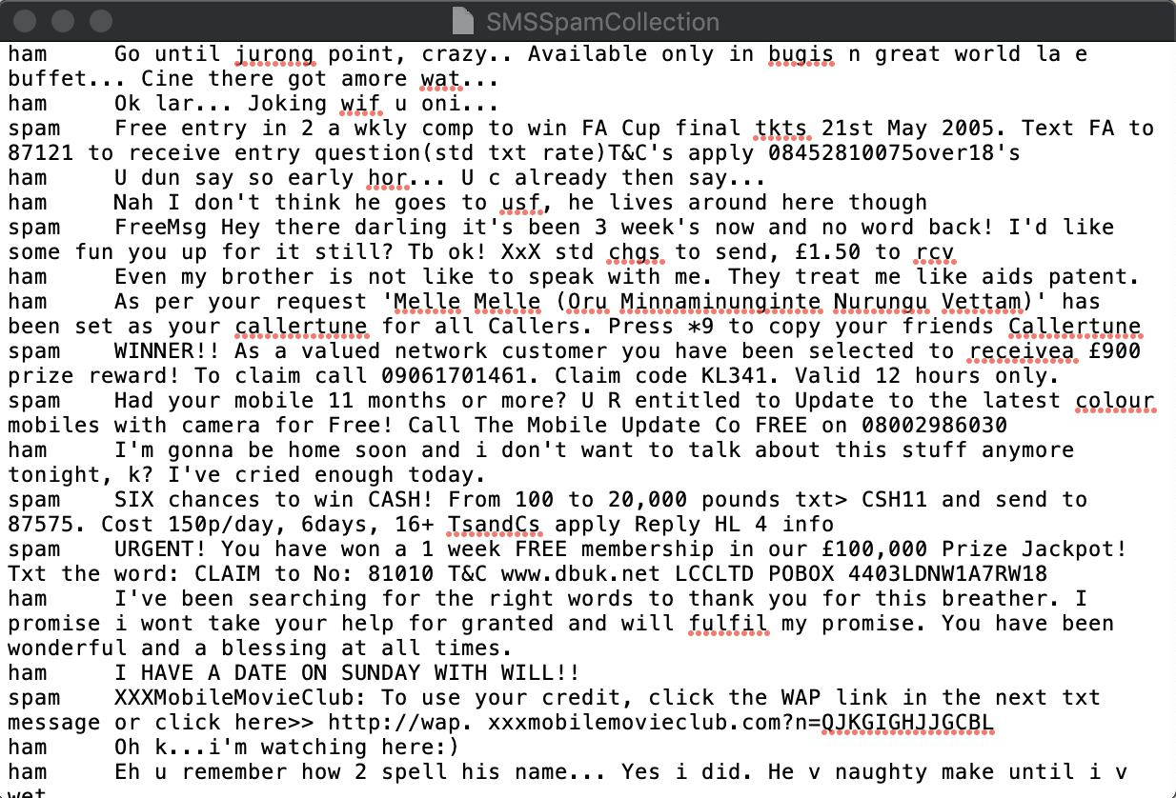
Data Source
Our data comes from UCI Machine Learning Repository, it is called SMS Spam Collection Data Set.

Slide 4
Spam classification
1. Text preprocessing
2. Language model
3. Topic model
4. Machine learning outcome

Slide 5
Text Preprocessing:
1. Noise removal --- stripping any text formatting (eg. HTML tags)
2. Tokenization --- breaking text into individual words
3. Normalization

Slide 6
Tokenization:
2.1 Parsing text :
1). Part-of-speech tagging (POS tagging): NLTK can identify part of text in the tag of verbs, nouns, adjectives fast and accurately.
2). Named entity recognition (NER): capture the topic of text, help to identify the proper nouns
3). Dependency grammar trees: help people understand the relationship of the words in sentence.
4). Regex parsing: using Python’s re library, when coupled with POS tagging, you can identify specific phrase chunks.

Slide 7
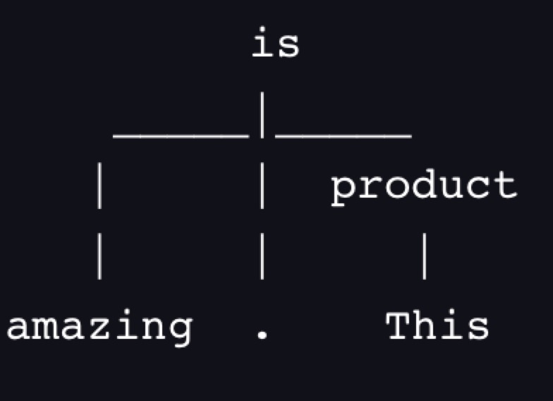
Dependency grammar trees
It mainly uses the recursive tree to separate the sentence. You can find it clearly the POS of each word.
Eg:

Slide 8
Normalization
3.1 Stemming: cut word prefixes and suffixes. “starting” and “started” change to “start”, but “sing” may become “s” and “sung” would remain “sung.”
3.2 Lemmatization: bring words down to their root form. Eg. “am” and “are” are related to “be.”
3.3 lowercasing, punctuation removal, stopwords removal, spelling correction, etc.

Slide 9
Compare between stemming and lemmatization
text | Stemmed text | Lemmatized text
so | so | so
many | mani | many
are | are | be
jumping | jump | jump
suitcases | suitcas | suitcase
tightly | tightli | tightly
went | went | go
arriving | arriv | arrive
noticed | notic | notice
barely | bare | barely
the | the | the
anywhere | anywher | anywhere
hardly | hardli | hardly
dentist’s | dentist, s | dentist, s

Slide 10
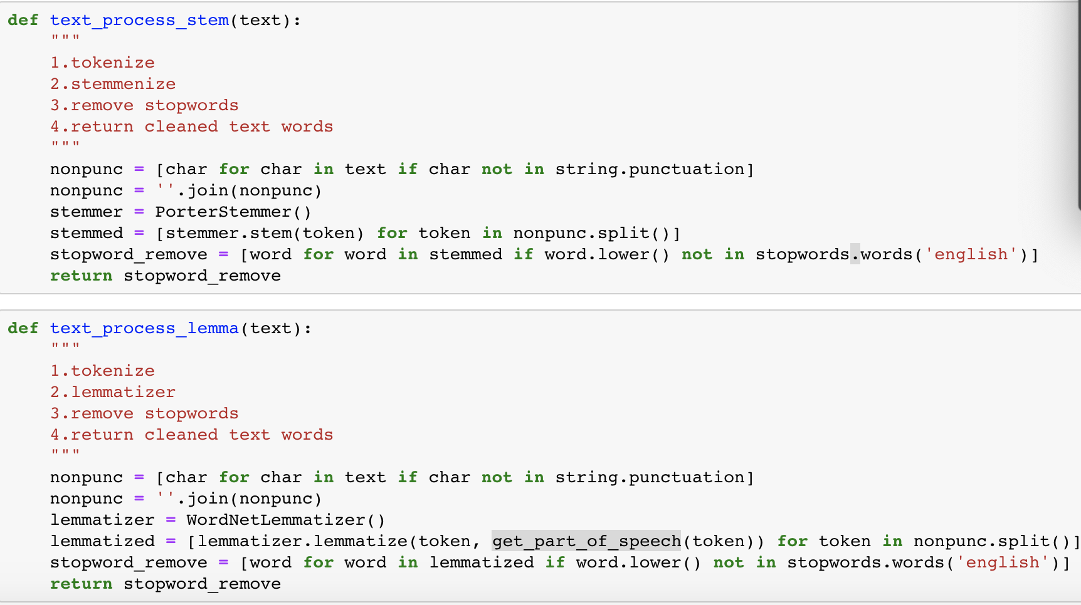
Compare between Stem and Lemmatization

Slide 11
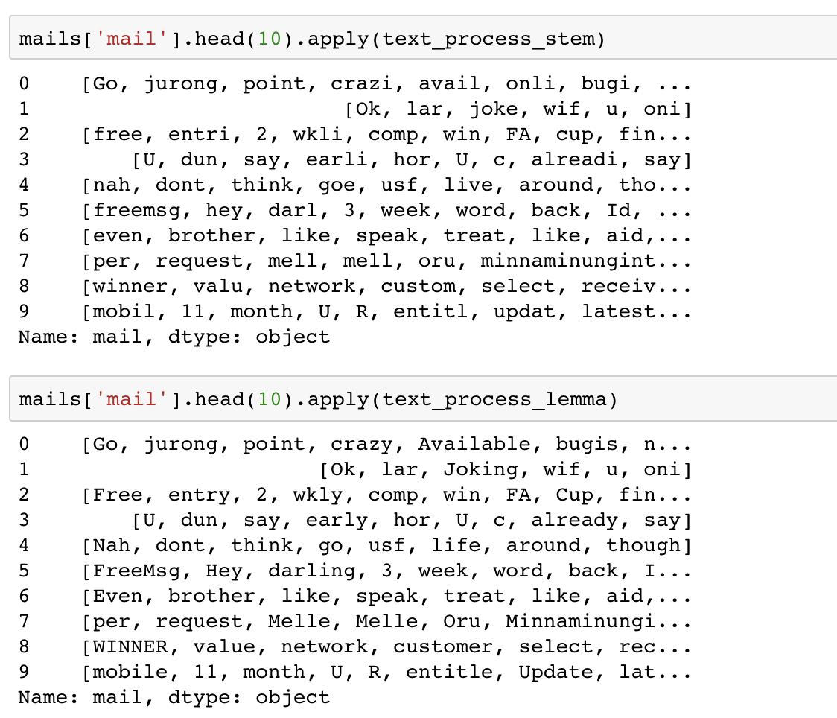
Compare between Stem and Lemmatization

Slide 12
Compare between stemming and lemmatization
Lemmatization is different from Stemming, it changes the words properly in the form of their root word belongs to the language. Stem might not be an actual word, but lemmatization is an actual word. Stemming follows an algorithm to perform words faster. However, lemmatization produce a word slower than stemming, it need to define a set of words in correct form.

Slide 13
Stop words
These words do not contain important significant meaning in search queries. We need to filter these words from search queries, because they will return a large amount of unnecessary information. In English words such as ‘the, be, are, as’ etc.

Slide 14
Language Model
1. Language prediction: Language Model – Bag of Words Approach
2. Attention to each word’s neighbors: Language Model – N- Gram and NLM

Slide 15
Language prediction
1.1 We can help computers make predictions about language by training a language model on a corpus. We build and use language models(probabilistic computer models of language) to figure out the possibility of letter, word, or phrase will be used. One of the most common language models is named bag of words. This model count of each word in this sentence.
Eg. “ The material of the product is amazing.”
After some preprocessing, bag of words would result in a mapping as below:
{“the”: 2, “material”: 1, “of” : 1, “product” : 1, “is” : 1, “amazing” : 1}
Despite of the different word order and sentence structure, Bag of words can be a great way for us to make prediction about text theme or sentiment.

Slide 16
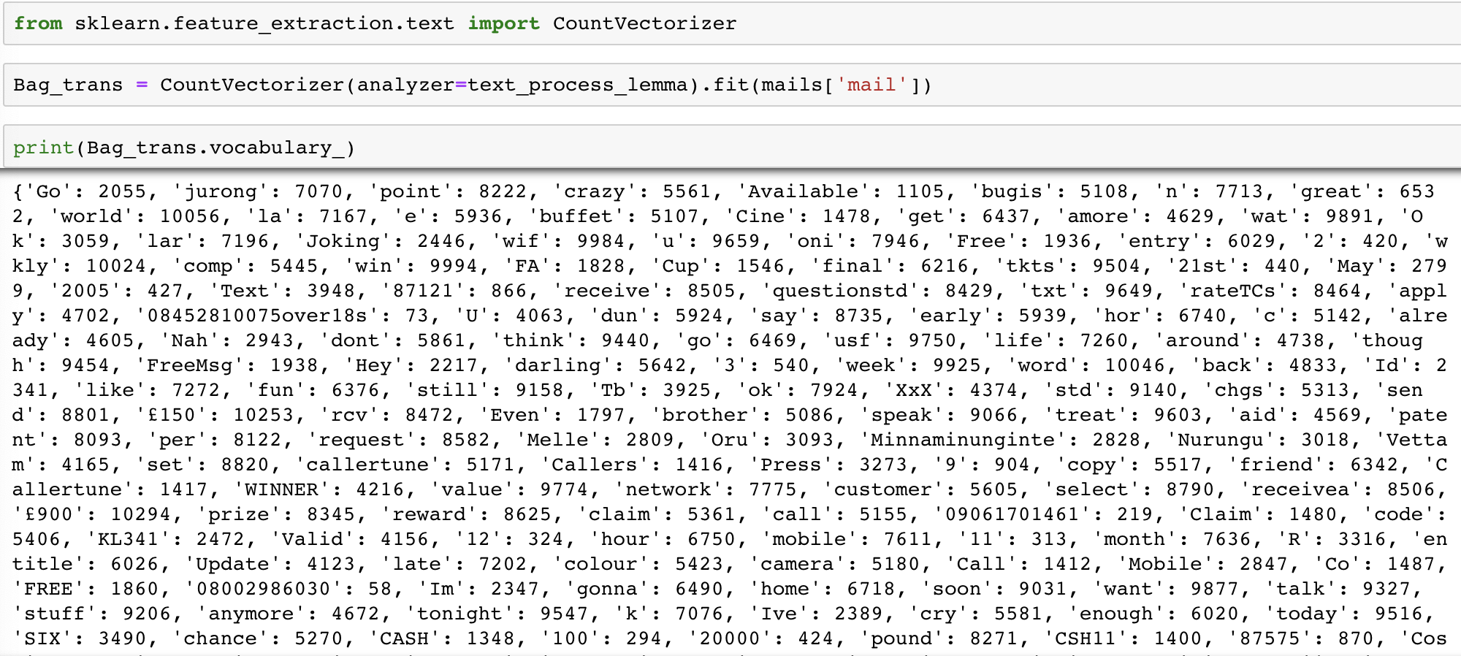
Count the word of all text

Slide 17
Language Model
1.2 In the project, we will convert each message into a vector the Scikit Learn’s algorithm models can work with.
Bag of words model:
1).Count how many times does a word occur in each message.
2).Weight the counts, so that frequent tokens get lower weight.
3).Normalize the vectors to unit length, to abstract from original text length.
This model will convert a collection of text documents to a matrix of token counts. It will be surely for the scikit learn to output a sparse matrix.

Slide 18
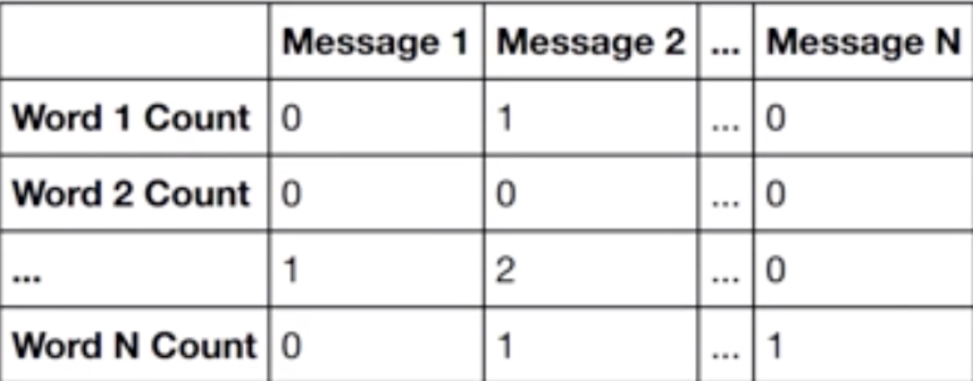
Language Model

Slide 19
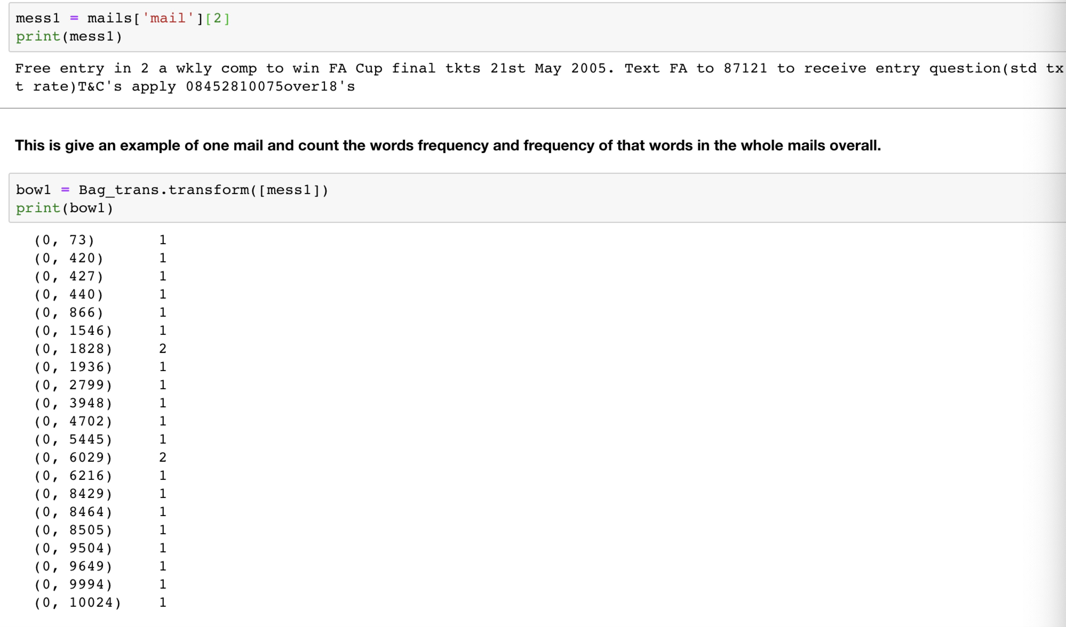
Transfer to vector

Slide 20
1.3 Addressing text similarity and spelling correction
To solving the problem of text similarity and spelling correction, we will consider about the Levenshtein distance or minimal edit distance between two words. This method is calculation the number of insertions, deletions, and substitutions between two words. Spelling correction need consider key distance on keyboard and technology of phonetic similarity.
Eg:
“amusing” & “amazing”, when “amusing” turn to “amazing”, it need “u → a, s → z”，two times substitution, so the Levenshtein distance would be 2.

Slide 21
2. Language Model –N-Gram and NLM
N-gram model considers a sequence of some number (n) units and calculates the probability of each unit in text. The larger n values can be impressive at language prediction.
Eg. “This product is amazing. This product has good quality. ”
The neighbors in these sentences count probability:
{(‘’,’this’) : 2, (‘this’,’product’) : 2, (‘product’,’is’) : 1, (‘is’,’amazing’) :1, (‘amazing’, ‘’) : 1, (‘product’,’has’) : 1, (‘has’,’good’) : 1, (‘good’,’quality’) : 1, (‘quality’,’’): 1}

Slide 22
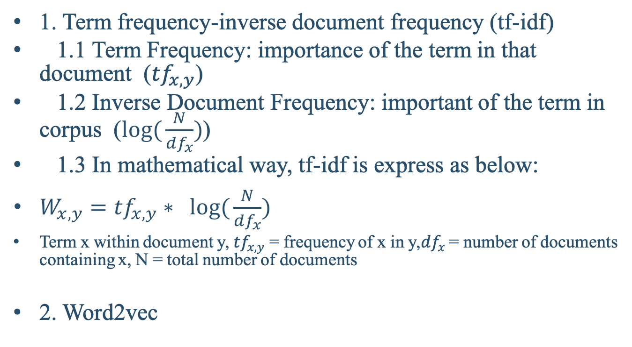
Topic Model
1. Term frequency-inverse document frequency (tf-idf)
1.1 Term Frequency: importance of the term in that document (${tf}_{x,y}$)
1.2 Inverse Document Frequency: important of the term in corpus ($log({\frac{N}{{df}_{x}}})$)
1.3 In mathematical way, tf-idf is express as below:
$W_{x,y}={tf}_{x,y}∗ log⁡({\frac{N}{{df}_{x}}})$
Term x within document y, ${tf}_{x,y}$ = frequency of x in y,${df}_{x}$ = number of documents containing x, N = total number of documents
2. Word2vec

Slide 23
1.Term frequency-inverse document frequency (tf-idf)
In the project, we found the answer of the question of ‘Why would you want to give more priority to less-used words?’, the reason is when we figure out a large amount of text, we found high probability in text are the words like “the”, “is”, “a”. If you want to determine your topic obviously, you need to use Python libraries genism and sklearn have modules to handle tf-idf.

Slide 24
Word2vec
word2vec is a great technique to have up your sleeve. word2vec can map out your topic model results spatially as vectors so that similarly used words are closer together.

Slide 25
Use Machine learning Model
In this project, we want to compare the difference between stem method and lemmatization method to process the data. And this is considered to be a key step to decide whether the process of the data is appropriate.

Slide 26
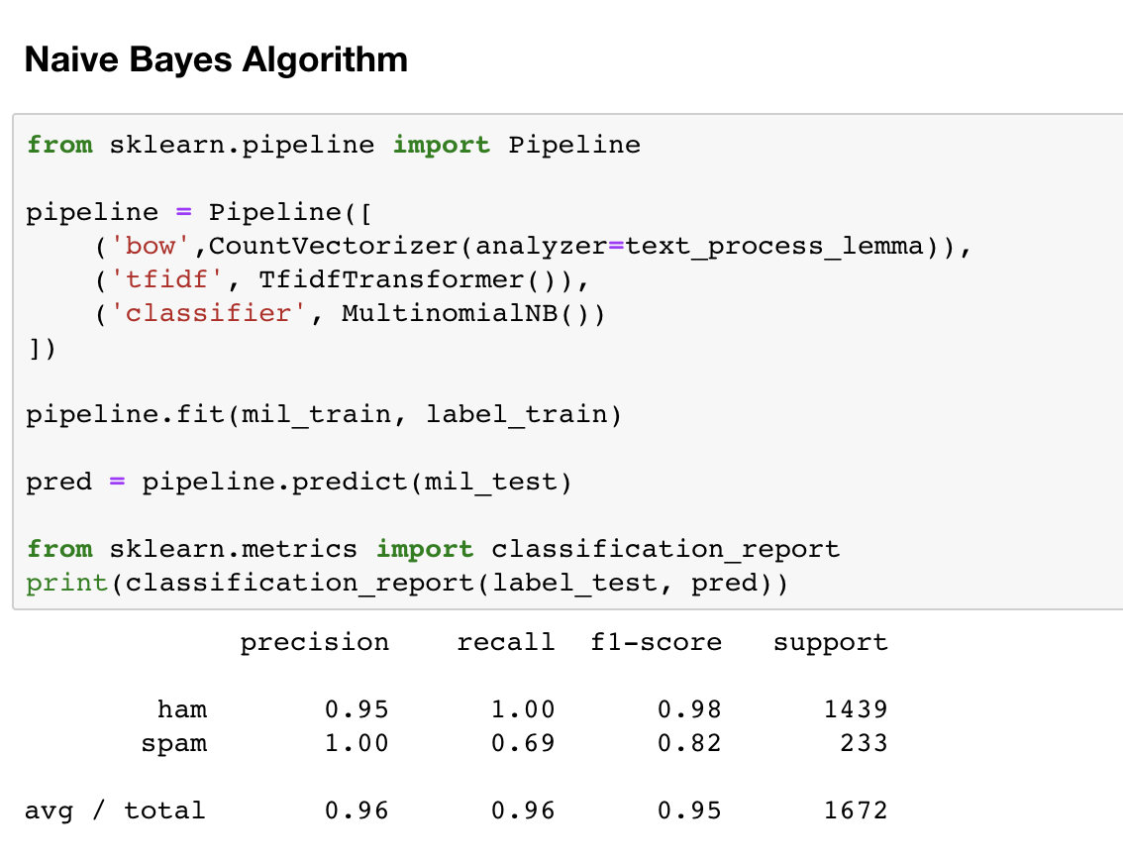
1.Naive Bayes
Lemmatization:

Slide 27
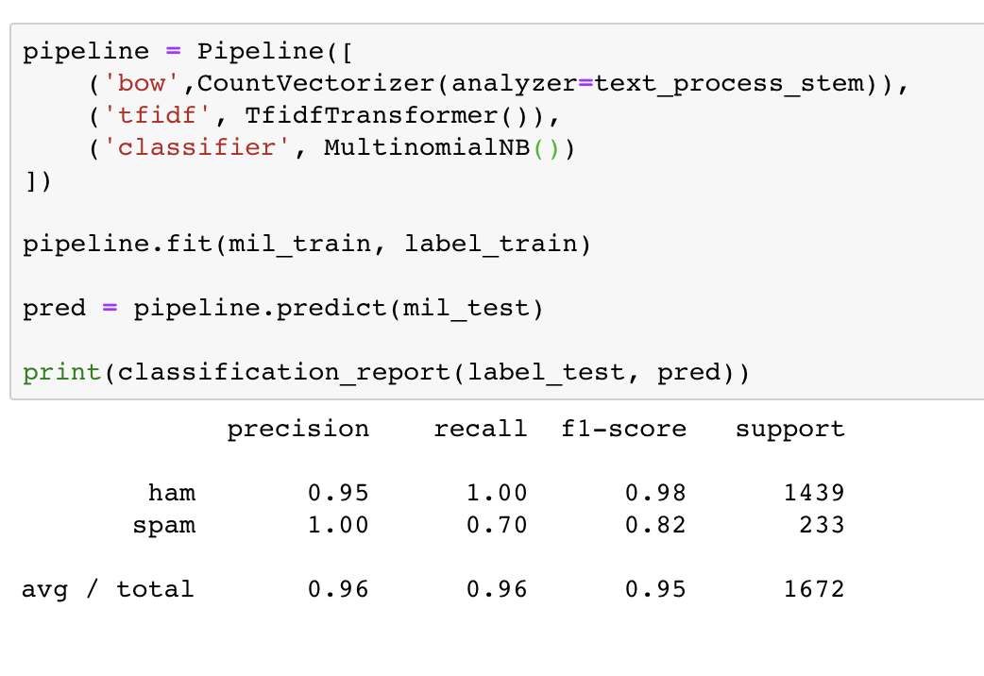
Naïve Bayes
Stem:

Slide 28
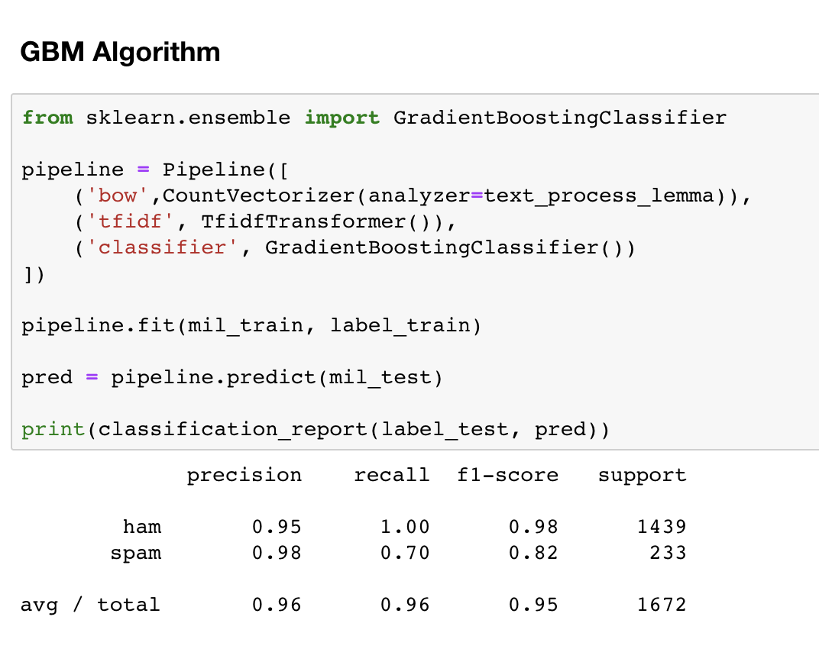
2.GBM
Lemmatization:

Slide 29
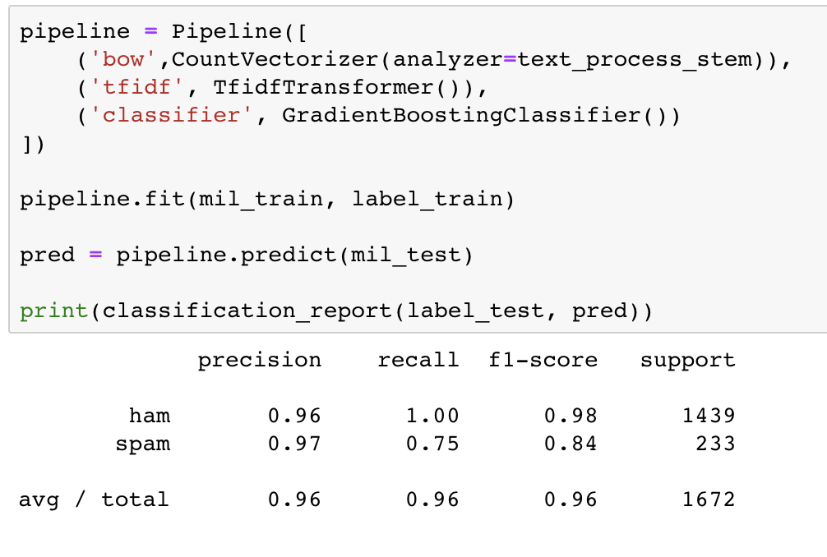
GBM:
Stem:

Slide 30
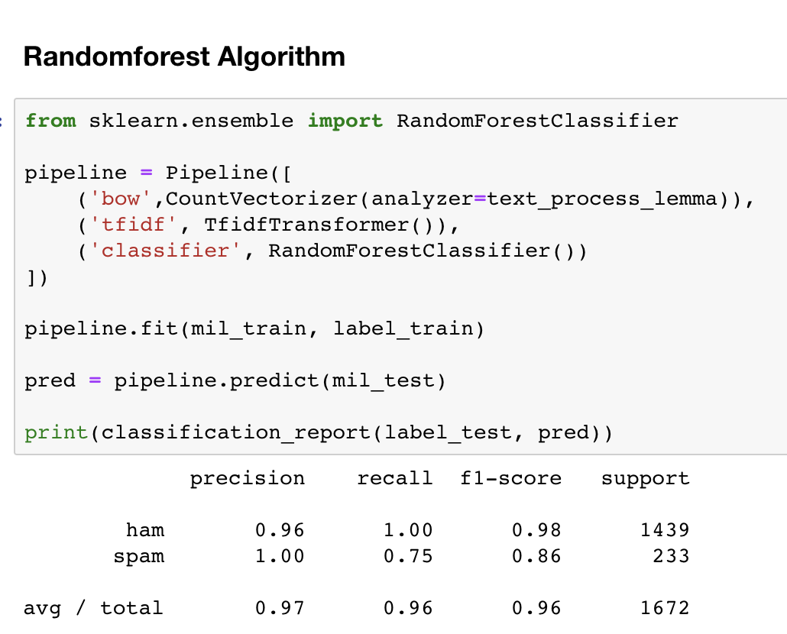
Random Forest
Lemmatization:

Slide 31
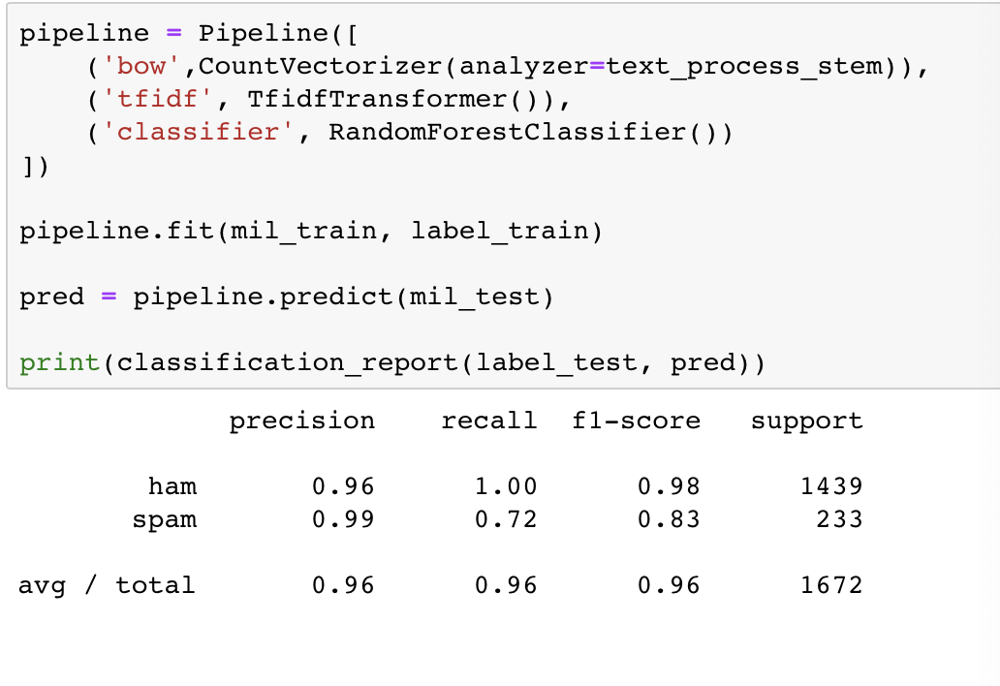
Random Forest
Stem:

Slide 32
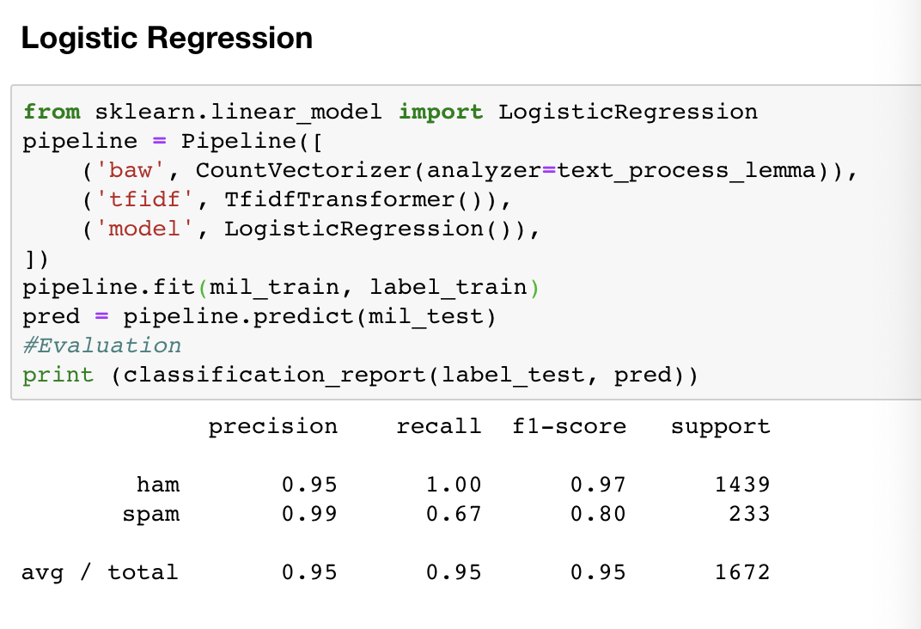
Logistic Regression
Lemmatization:

Slide 33
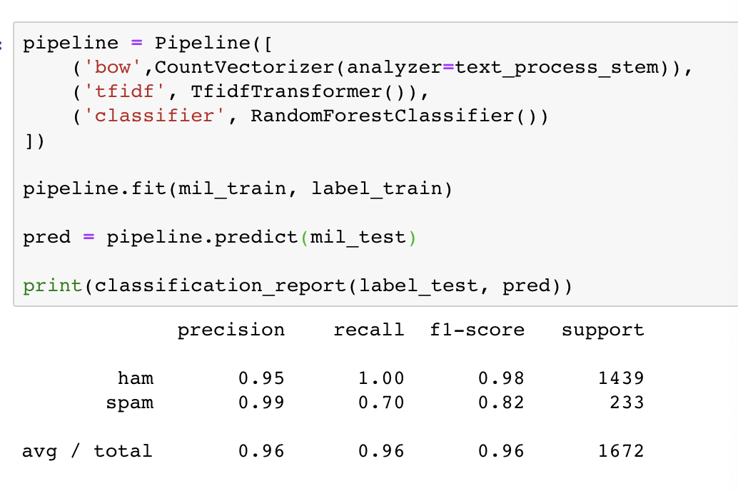
Logistic Regression
Stem:

Slide 34
The next steps
1. Text preprocessing: Named entity recognition (NER): capture the topic of text, help to identify the proper nouns
1.1 Regex parsing: using Python’s re library, when coupled with POS tagging, you can identify specific phrase chunks.
2. Language Model:
3. Topic model: 4. Machine learning model:

Slide 35
2.Language Model
Language Model – N- Gram and NLM: In this model. We will take the phrase into consideration , and analysis how the chunk of the text decide the classification problem.

Slide 36
Topic Model
Word2vec: Analysis the “The word embedding”, it can mapout topic model results spatially as vectors so that used words are close together.

Slide 37
Machine learning model
Neural Network classification: Neural Network is another important way in NLP to classify the text-based problem
AUC to check the fittness of the model.

Slide 38
Professor’s comment
Create a base model using tokenization without stem, Lemmatization, and Word2vec.
Evaluate the base model, if the accuracy is not too large, it means the model is good enough and has the chance to be modified using methods I mentioned
If not, find a good model to let the accuracy not too high.
Then using the methods to increasethe accuracy of the base model.

